Slide 1


Slide 2

SECTOR 02 · SMART SOCIETY & PUBLIC SERVICES · JORDAN
Bridgecom
From where you are to where you could be.
One profile that walks a Jordanian student from school, to university, to a first job, and explains every step.
Live: bridgecom.onrender.com AI Quest 2026
Notes:
0:00 to 0:20 (20 s). Open with the tagline. 'Every Jordanian student crosses three bridges: school to university, university to opportunity, learning to a job. Today they cross them alone. Bridgecom is one profile that walks with them.'

Slide 3
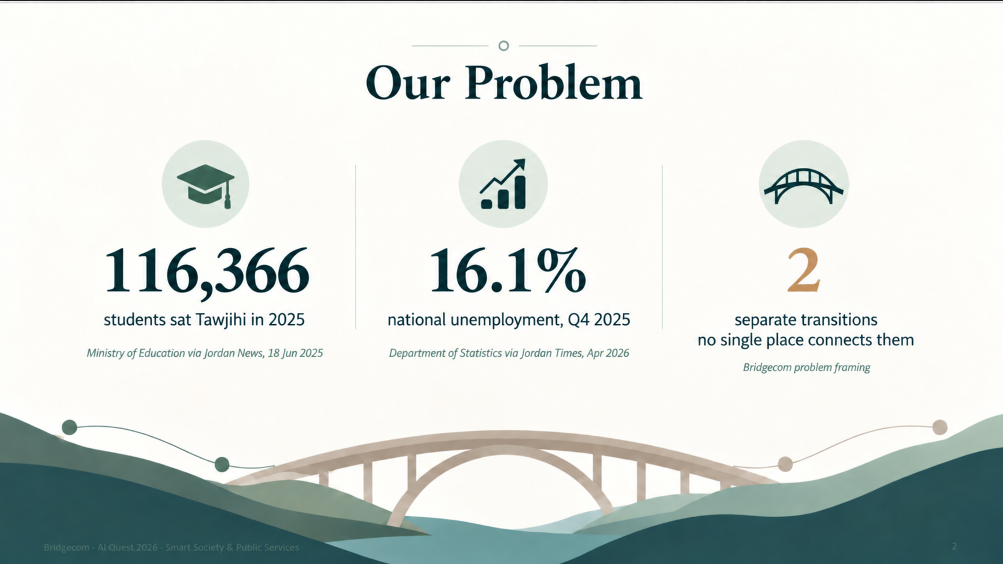
Notes:
0:20 to 1:00 (40 s). 'Last summer almost 210,000 students sat Tawjihi. Each one had to choose a program from fee PDFs spread across university sites, and most families confuse the minimum to apply with the competitive cut-off. Then at university, everything a student builds outside the exam is invisible. And employers, who cannot see skills, filter on grades. Three transitions, no single place that connects them.' Sources on the slide.

Slide 4
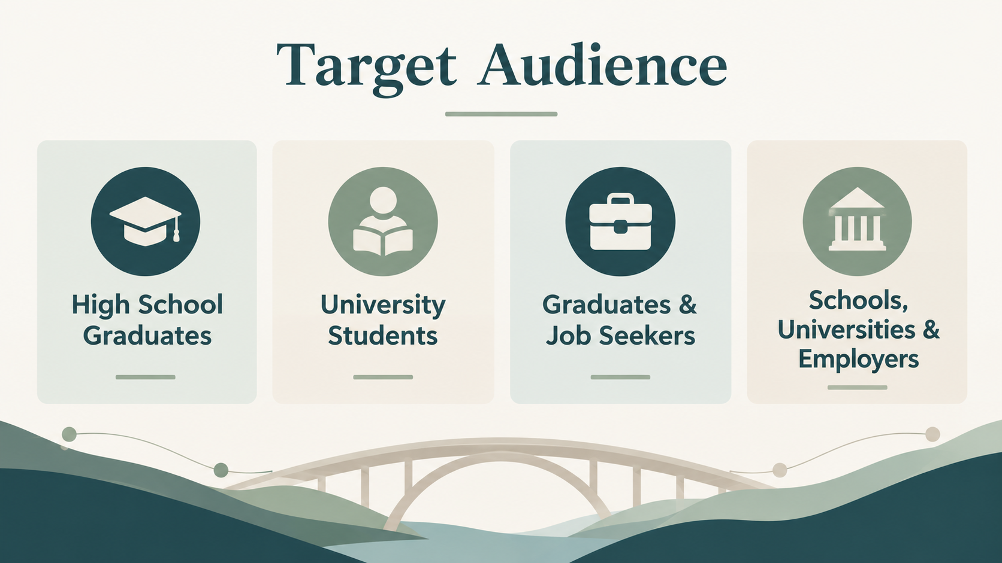

Slide 5
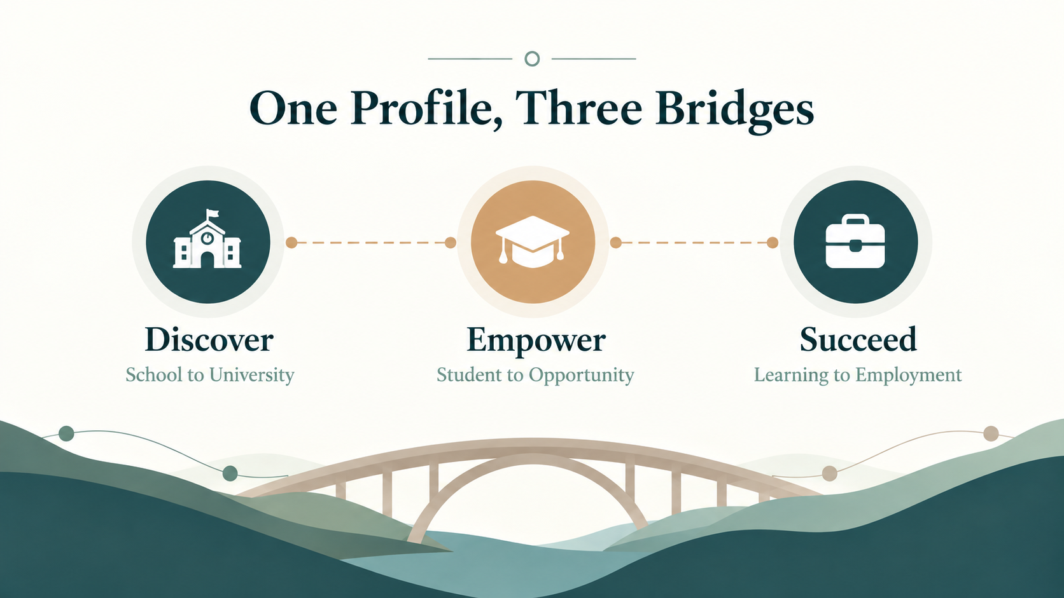
Notes:
1:00 to 1:30 (30 s). 'Bridgecom is one profile with three stages. Discover, Empower, Succeed. And one rule we never break: the AI reads language and explains, but eligibility, cost and readiness come from rules over sourced, dated records. Let me show you.' Switch to the browser.

Slide 6
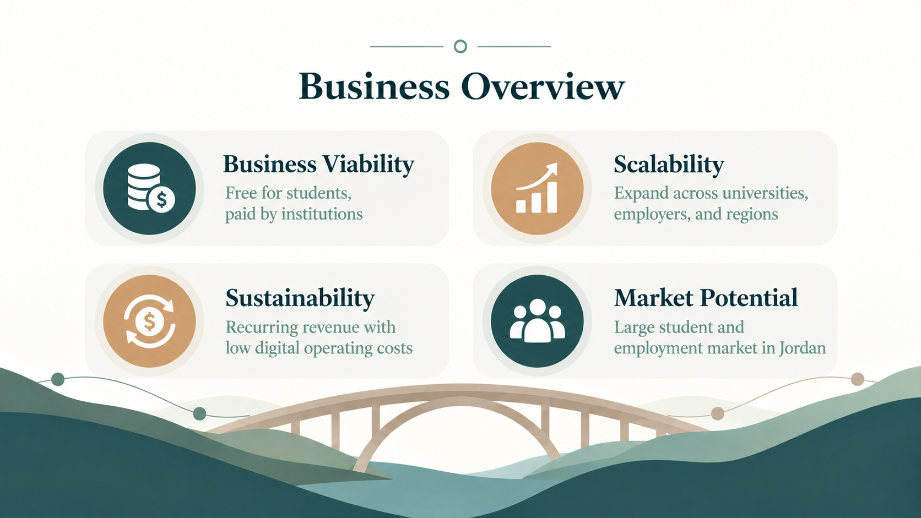

Slide 7
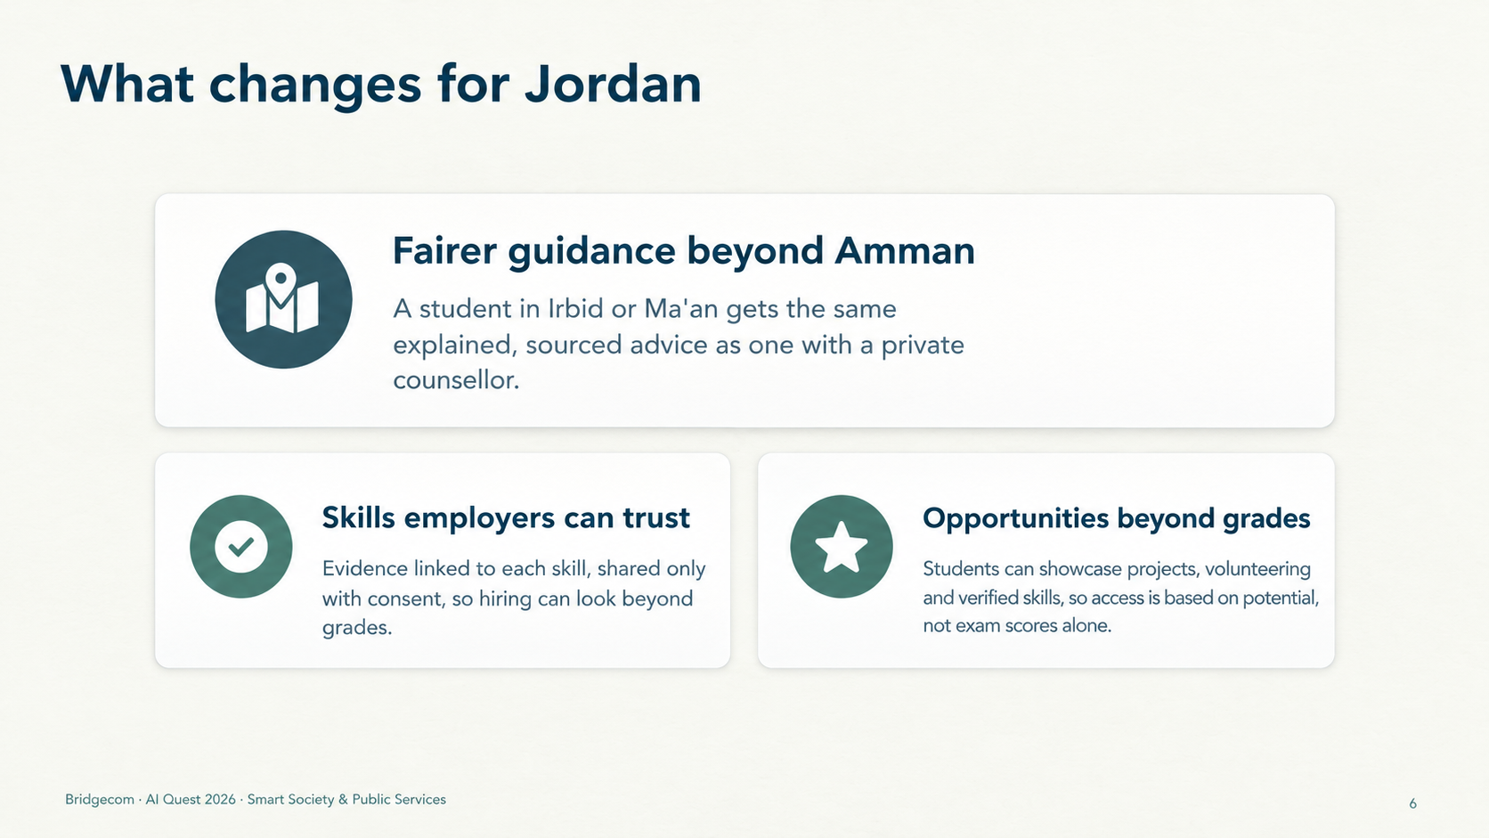
Notes:
6:05 to 6:35 (30 s). 'For Jordan this means fairer guidance outside Amman, honest costs for families before they apply, skills employers can trust, and anonymised data that shows decision-makers where students struggle. In the pilot we will measure completion, source coverage and evidence-backed skills.'

Slide 8
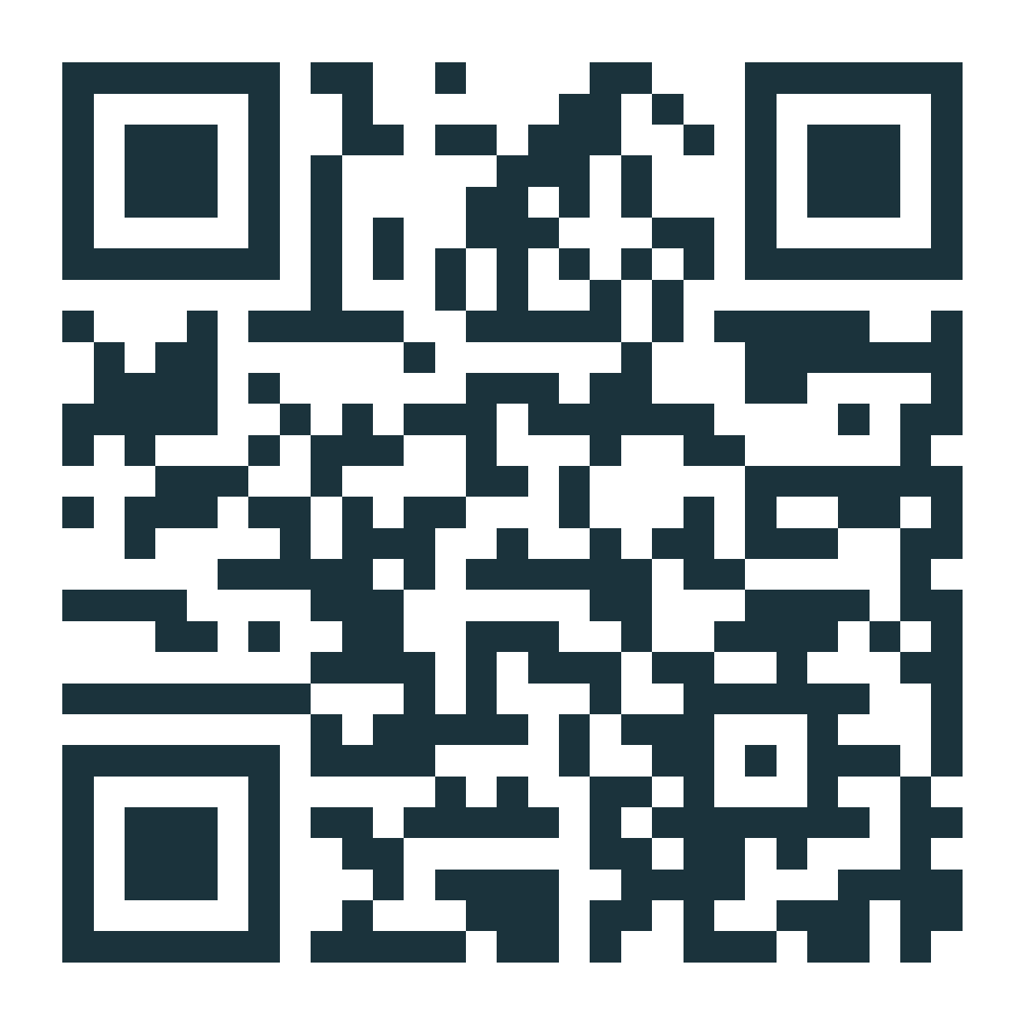
OUR ASK
Help us pilot it this Tawjihi season
Schools in one governorate to run the pilot
Scan to try it live
1
2
Data access to official admission and fee records
3
Employers willing to post skills-based roles
From where you are to where you could be.
bridgecom.onrender.com github.com/Ezz-Banna/Cloud-AI-Quest-2026
Notes:
6:35 to 7:00 (25 s). 'Our ask is simple: schools in one governorate to pilot with us this Tawjihi season, access to the official admission and fee records, and employers willing to hire on evidence. Bridgecom: from where you are to where you could be. Thank you.' Stop. Q&A follows (3 minutes).

Slide 9
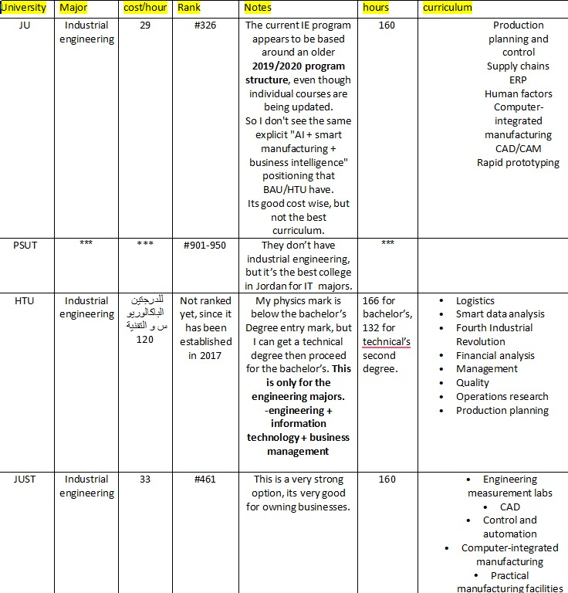
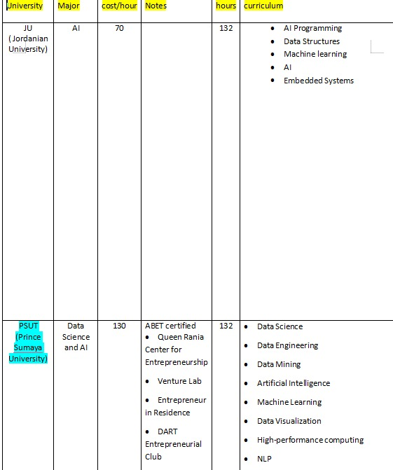

Slide 10
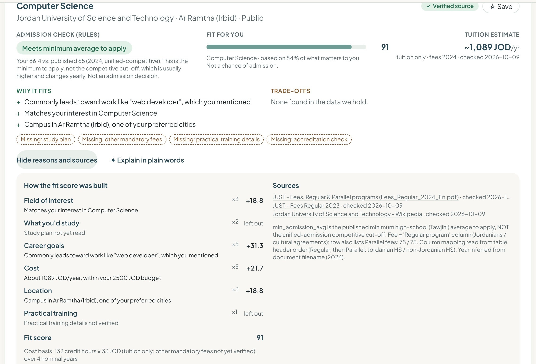
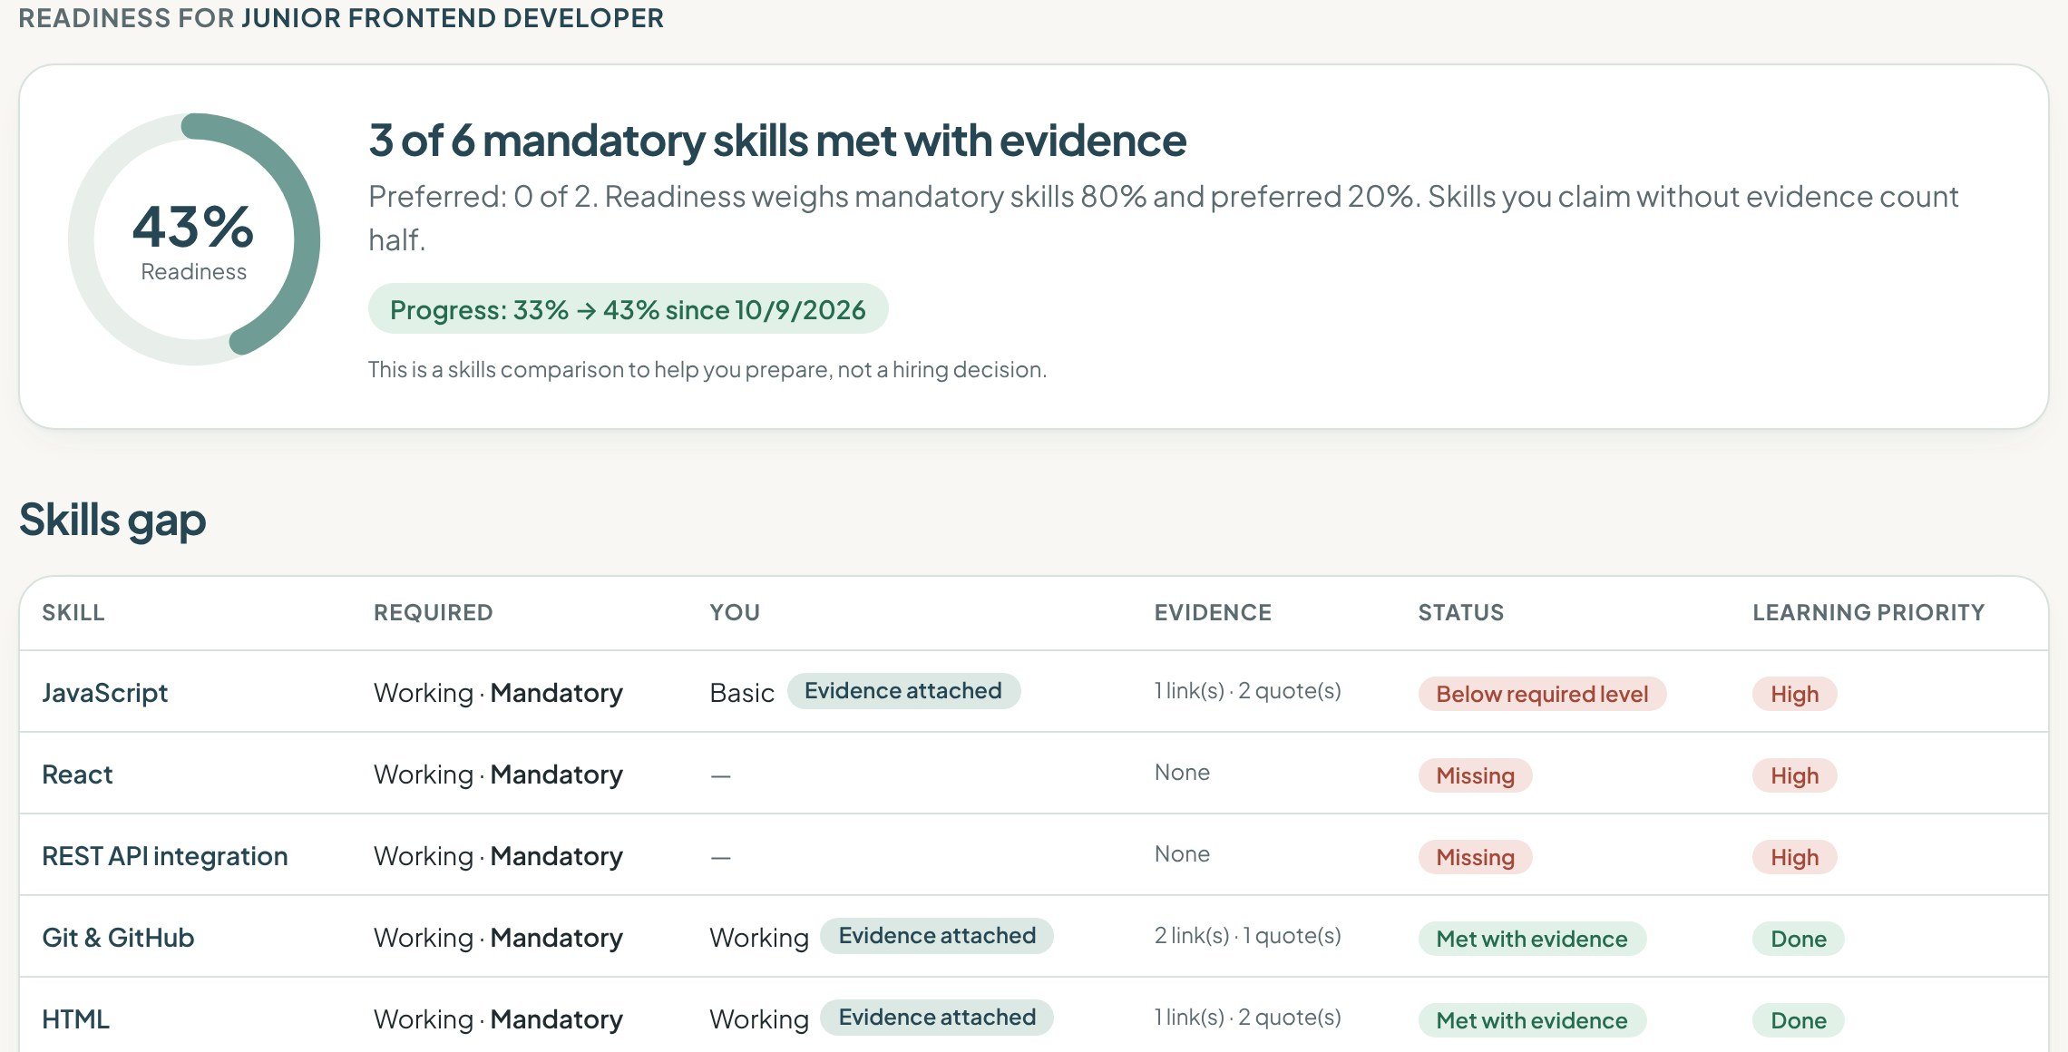
Backup: the working build, if the network fails
Screenshots recorded from the submitted build on 9 Oct 2026, running offline rules. Lina and all employers are synthetic demo data.
Notes:
Backup only. Use if the live site or network fails during the demo.

Slide 11
Backup: answers for the 3-minute Q&A
Does the AI decide admission?
What if the data is wrong or old?
No. Eligibility, cost and readiness are rules over sourced records. The AI reads text and explains; any number it invents is caught and replaced by a template.
Every record has a source and a check date. Records older than 180 days and conflicting sources are flagged, and disputed facts are left out of scoring.
How much data today?
Personal data?
11 universities and 44 programs in 8 fields, 13 scholarships, 45 courses. A sample built for depth; the import and audit pipeline is ready for national coverage.
The profile stays on the student's device. Sharing is opt-in and revocable, and never includes grades, city, budget or accessibility needs.
Why not just use a chatbot?
What is mocked?
A general chatbot invents fees and cut-offs. Bridgecom grounds every fact in a dated source and tests that it does.
The demo student and all employers are synthetic and labelled. Live AI needs an API key; without it, rules take over and say so on screen.
Notes:
Backup only, for Q&A.

